Slide 1

Using citizen knowledge to model urban deprivation
Rowland Seymour

Slide 2

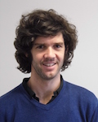
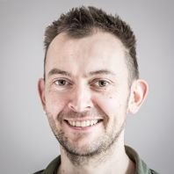
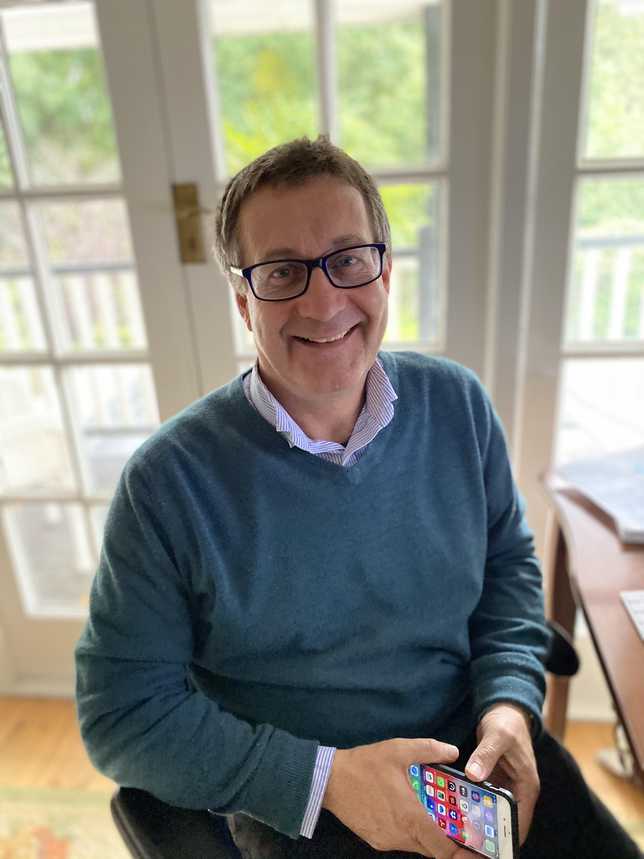
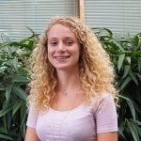


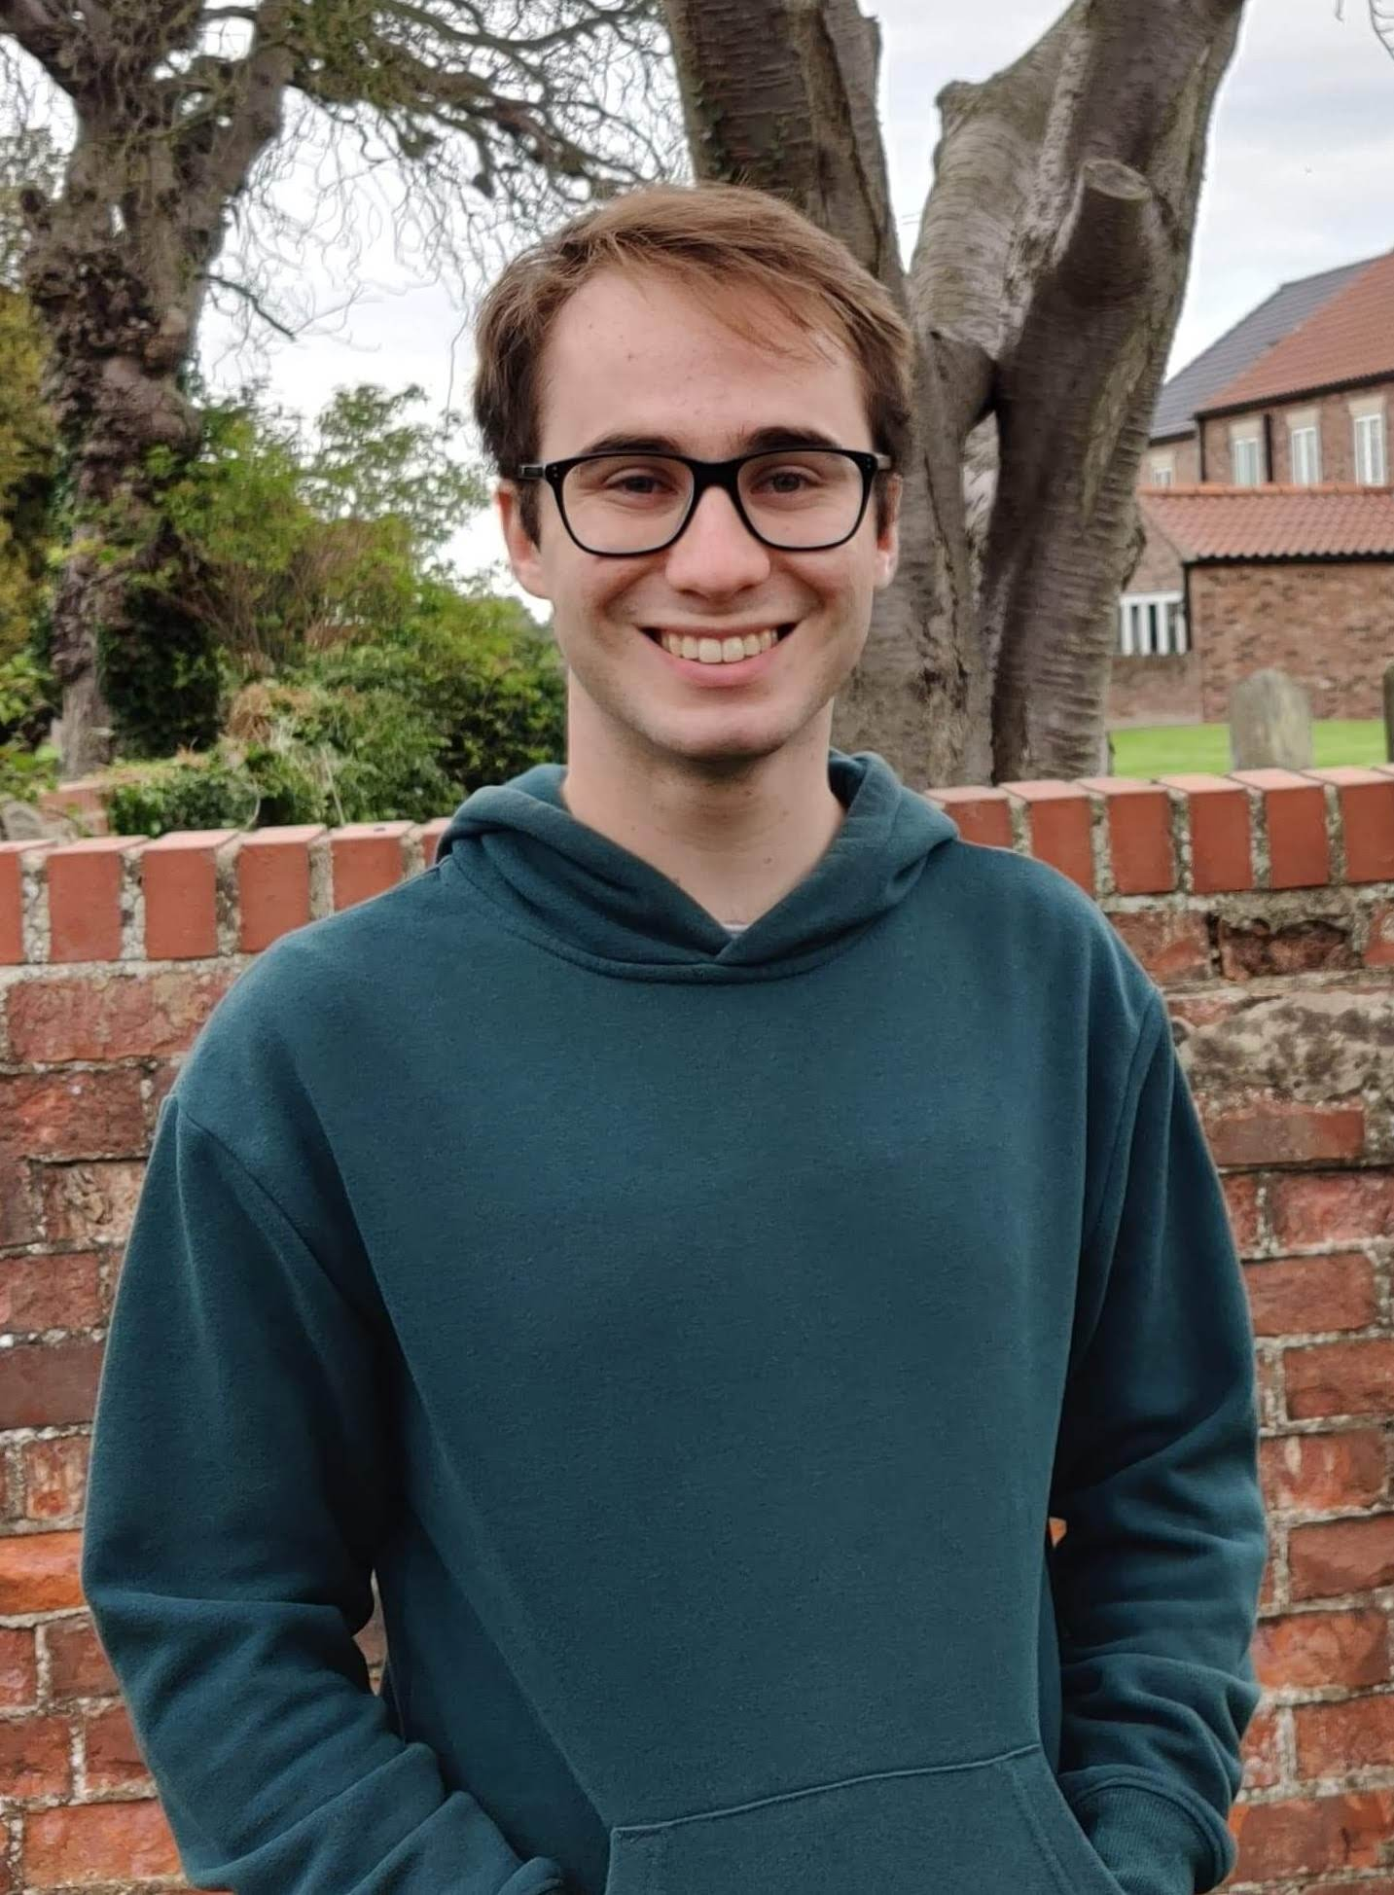
Meet the team
Rowland Seymour,
Research Fellow
David Sirl,
Lecturer
Simon Preston,
Associate Professor
Ian Dryden,
Professor of Statistics
Madeleine Ellis,
Research Fellow
Bertrand Perrat,
Assistant Professor
James Goulding,
Assistant Professor
James Briant,
Undergraduate

Slide 3
Using official statistics
All items on these slides are editable. You can change the colour, outline and size easily as you do with other PowerPoint shapes.
We are interested in estimating the deprivation in different parts of Dar es Salaam, Tanzania.
Dar es Salaam is the largest city in Tanzania, with over 6 million inhabitants.
The city is expected to double in size in the next 10 years and 70% of citizens already live in informal residences.

Slide 4
Using official statistics
All items on these slides are editable. You can change the colour, outline and size easily as you do with other PowerPoint shapes.
In developed countries, we would use:
Census data
Economic indicators
Health and education statistics
In less developed countries, these are often:
Unavailable
Unreliable
Out of date

Slide 5
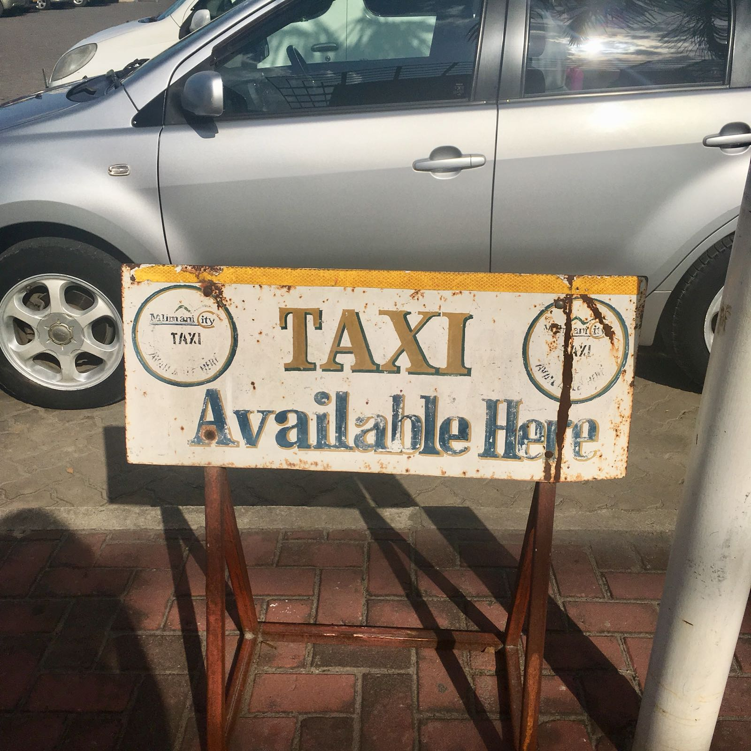
Using official statistics
All items on these slides are editable. You can change the colour, outline and size easily as you do with other PowerPoint shapes.
Citizens are experts in their own city and have opinions that are:
Reliable
Up to date
Nuanced
A taxi rank in Dar es Salaam

Slide 6
Citizen judgements
All items on these slides are editable. You can change the colour, outline and size easily as you do with other PowerPoint shapes.
Absolute judgement
On a scale of 1 to 10, area A is a 6 out of 10.
Comparative judgement
Area A
is more affluent than
Area B.

Slide 7
Citizen judgements
All items on these slides are editable. You can change the colour, outline and size easily as you do with other PowerPoint shapes.
Absolute judgement
On a scale of 1 to 10, area A is a 6 out of 10.
Comparative judgement
Area A
is more affluent than
Area B.

Slide 8
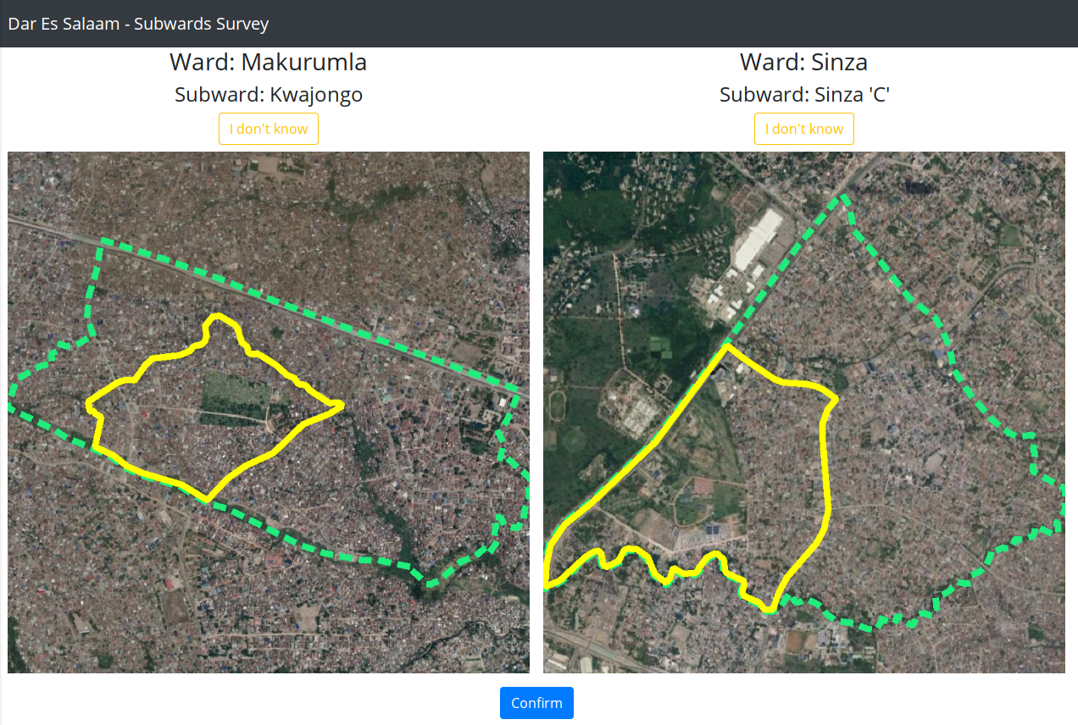
Collecting judgements

Slide 9
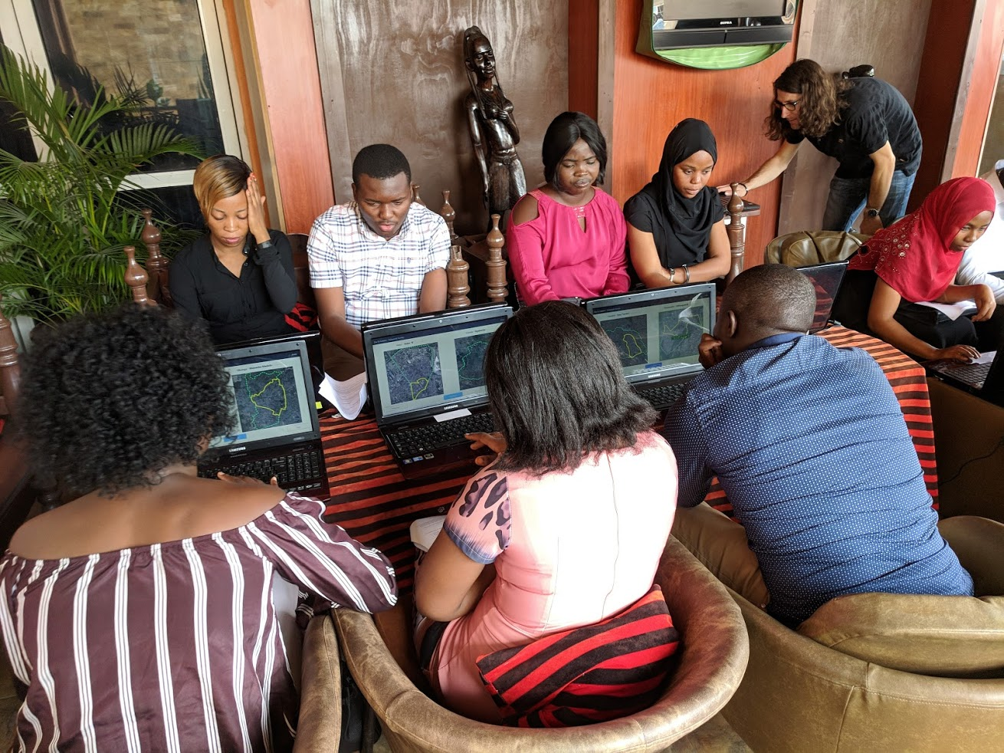
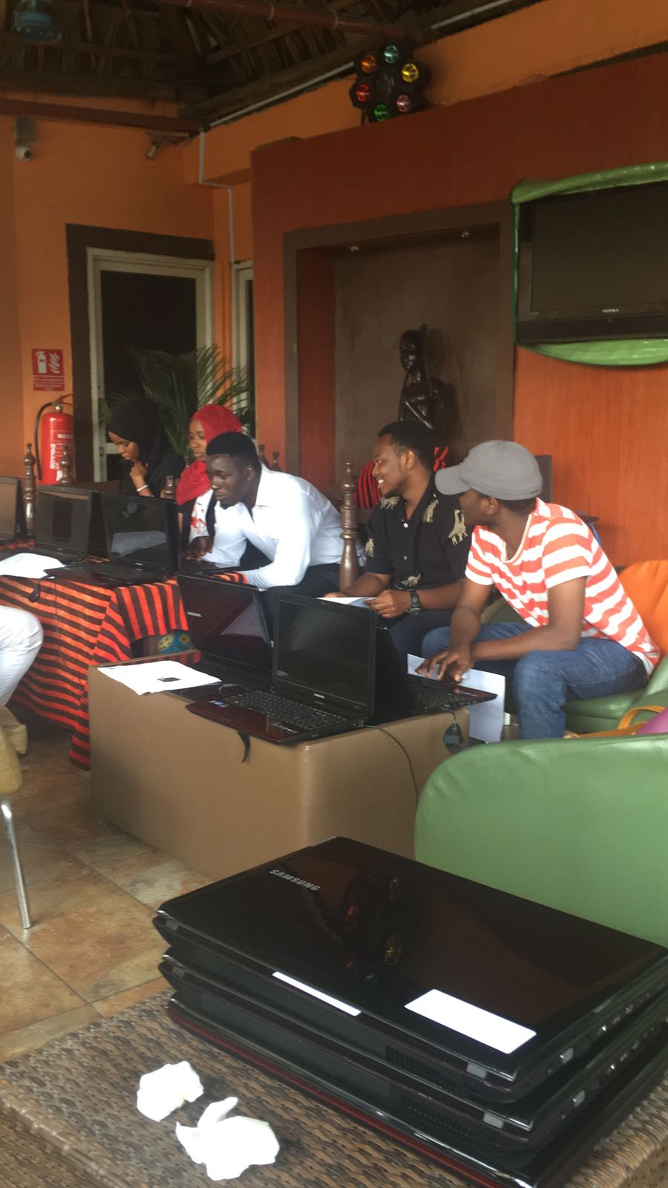
Collecting judgements
In August 2018, we:
collected over 75,000 comparisons,
from over 200 judges,
in 17 data collection sessions.

Slide 10


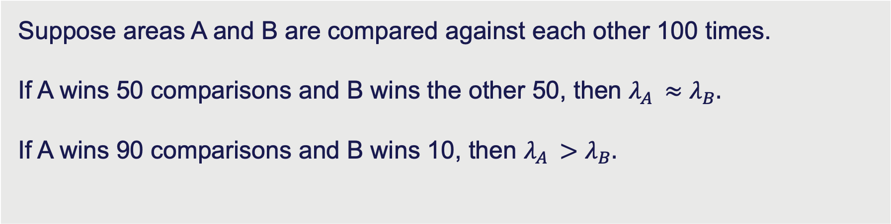
Mathematical modelling
Each area has a level of deprivation, $λ$, which we want to estimate from the comparative judgements.
$$λ$$
0
More deprived
More affluent
Suppose areas A and B are compared against each other 100 times.
If A wins 50 comparisons and B wins the other 50, then $λ_{A }≈$ $λ_{B}.$
If A wins 90 comparisons and B wins 10, then $λ_{A }>$ $λ_{B}.$

Slide 11
Mathematical modelling
Each area has a level of deprivation, $λ$, which we want to estimate from the comparative judgements.
$$λ$$
0
More deprived
More affluent
Suppose areas A and B are compared against each other 100 times.
If A wins 50 comparisons and B wins the other 50, then $λ_{A }≈$ $λ_{B}.$
If A wins 90 comparisons and B wins 10, then $λ_{A }>$ $λ_{B}.$

Slide 12
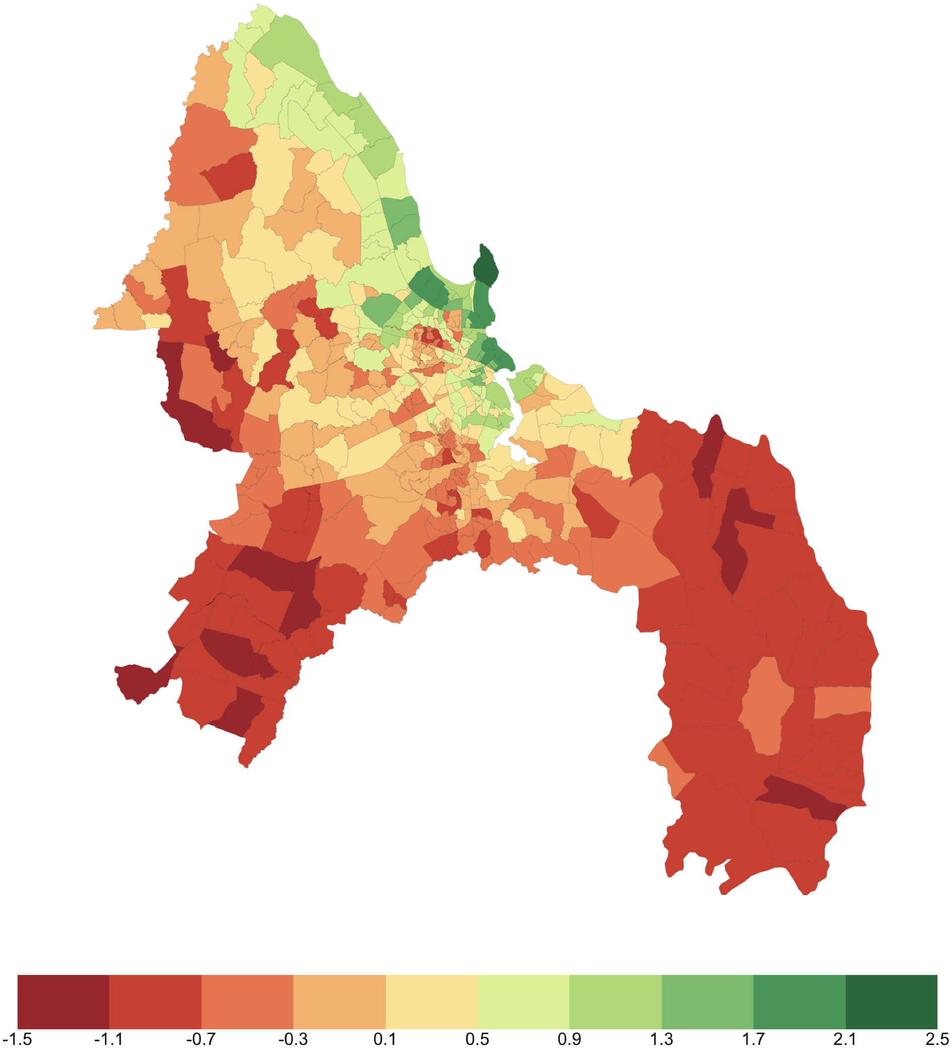
Deprivation in Dar es Salaam
We estimated the level of deprivation in each area of the city.
There are north-south and costal-interior trends.
We identify several slums in the centre of the city.

Slide 13
Gender differences
We analysed if there was a difference between men and women’s perceptions.
Women perceived the green areas as more affluent than the men did, and red areas as more deprived.

Slide 14
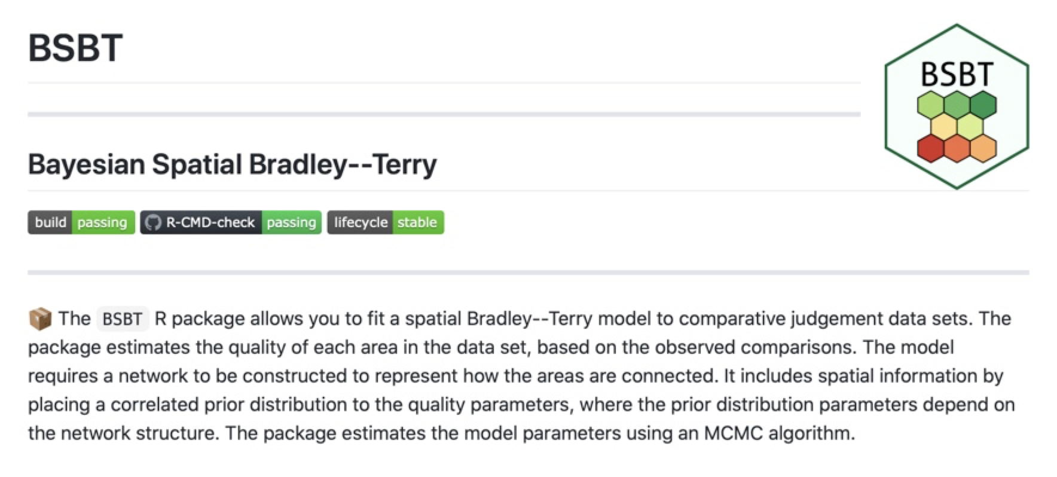
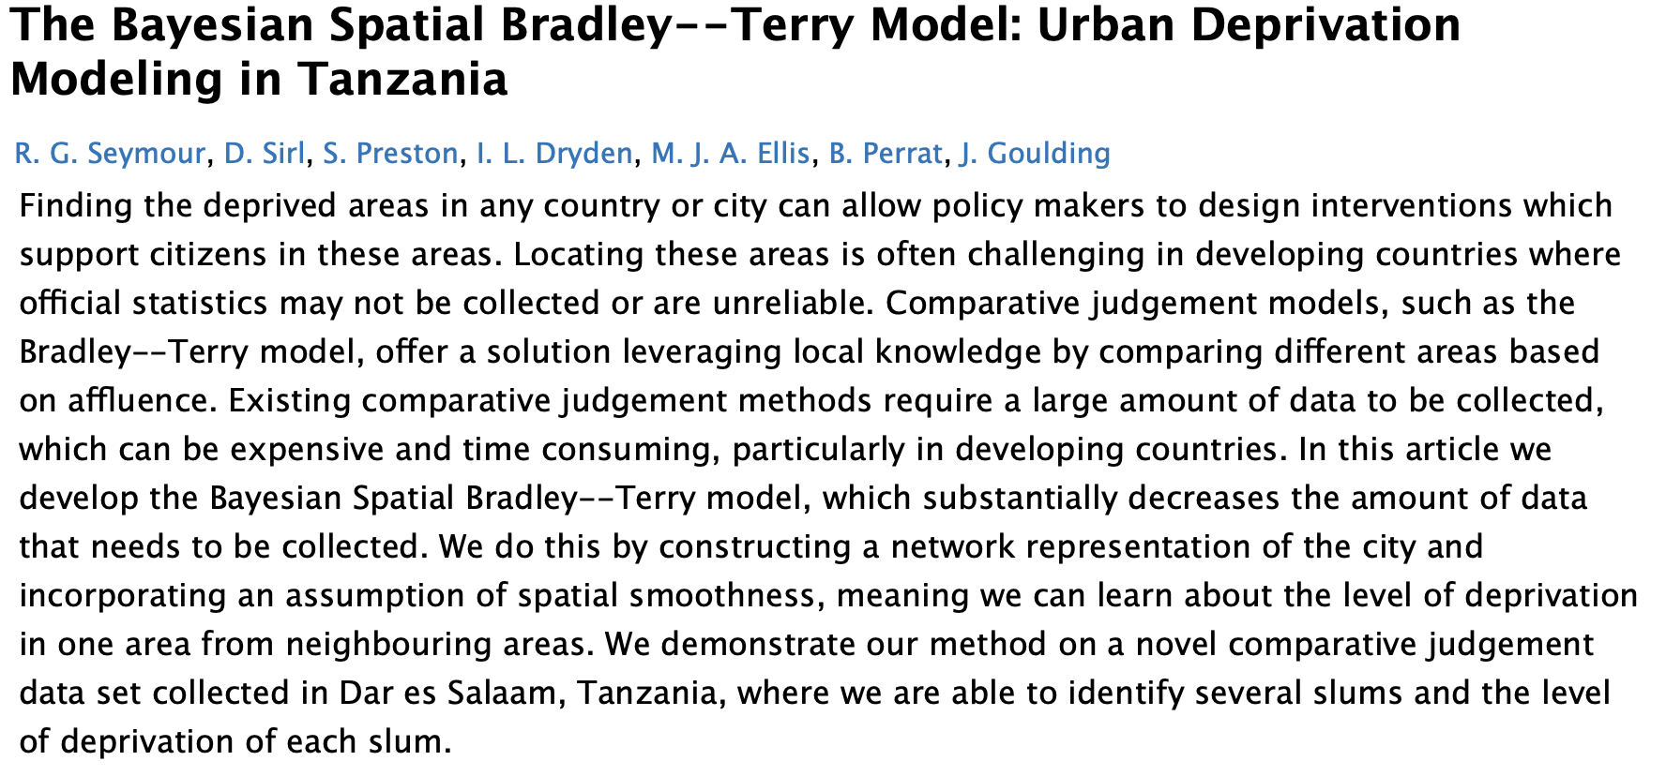
More information
Get hands on with the data
Read more about the details
github.com/RowlandSeymour/BSBT
arXiv:2010.14128

Slide 15
Thank you

